Slide 1
Group 14
Jamie Owers, Rhys Richmond, William Lennox & Serban-Dumitru Nacu

Slide 2
Key elements of the brief
Consider a genre
Remove the mechanic
Substitute the mechanic with a refined new solution
Single player

Slide 3

Solution of the brief
Movement Mechanic Slingshot
Easy fun - curiosity, wonder.
Hard fun – frustration, release of tension
Meaningful choice

Slide 4
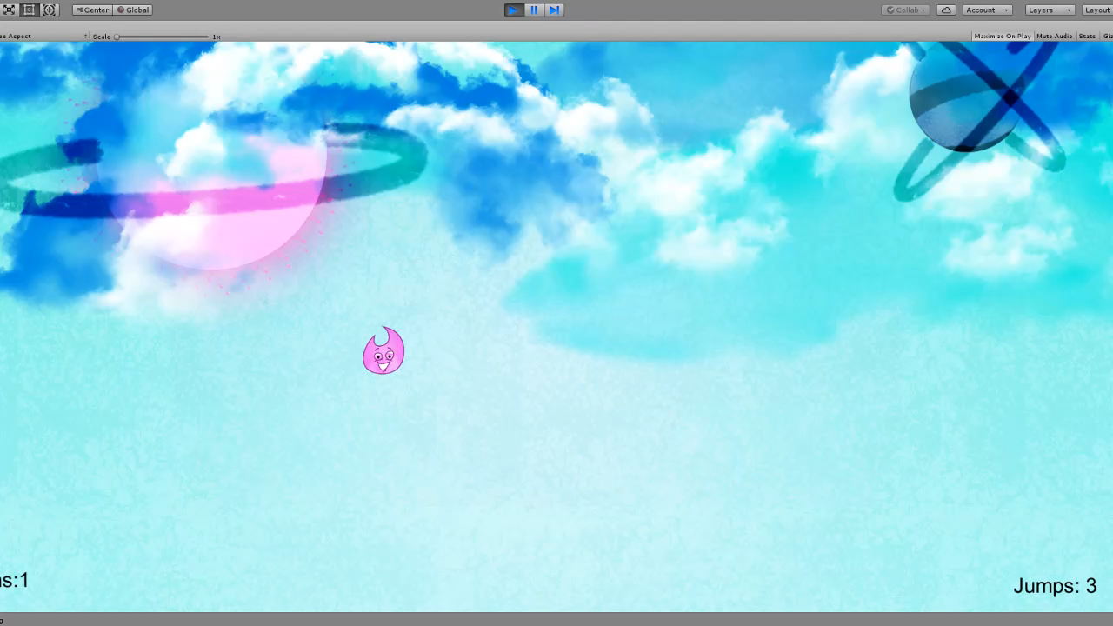
Video walkthrough of the game

Slide 5

List of deliverables
Programming
Level Design
Character Animations
Playtesting
Art assets – Platforms, buttons, UI

Slide 6

Questions?

